Slide 1



INTELLIGENT INSTANT BRICK KILNS MACHINE
Presented by :
510516106003 : T. DINESH KUMAR
510516106006 : N. KALAIDASS
510516106012 : T. RANJITH KUMAR
Department of Electronics and Communication Engineering,
Bharathidasan Engineering College, Nattrampalli
Guided by:
Mr. P. RAJKUMAR. M.E., A.P(ECE),
Department of Electronics and Communication Engineering,
Bharathidasan Engineering College, Nattrampalli
.

Slide 2
ABSTRACT
Nowadays clay brick kilns are possible by using large quantities of wood. To kiln the 60 thousand bricks approximately 9 tones of wood is required and it takes 15 to 20 days of duration. Many trees are cut down to satisfy the requirement.
As a result we are significantly contributing to global warming and polluting the atmospheric air.
In the world wide nearly 15%(5.52 billion tonnes) of carbon emission is done by traditional brick kilns, and 5% of bricks were wasted while the kilnsing process.
For all these problems we are with a solution to the proposal “INTELLIGENT INSTANT BRICK KILNS MACHINE”, in this we can get instantly finished bricks from the machine by using the electric furnace. We can reduce the deforestation and emission of harmful gases from the kilnsing process.
.

Slide 3
INTRODUCTION
The brick was discovered by Jordan Valley in 7000 BC in Turkey.
A brick is a type of construction material used to build walls, The first brick hiving dimensions of 400*150*100 mm.
The first bricks, made in areas with warm climates, were mud bricks dried in the sun for hardening.
Properly, the term brick denotes a block composed of dried clay, but is now also used informally to denote other chemically cured construction blocks.
.

Slide 4
GENERAL PHASES
The manufacturing process has six general phases:
Mining and storage of raw materials.
Preparing raw materials.
Forming the brick.
Drying.
Firing and cooling.
De-hacking and storing finished products.
.

Slide 5
PROBLEMS AND THE SOLUTION
Global energy-related CO₂ emissions grew in 2022 by 0.9%, or 321 million tonnes, reaching a new high of more than 36.8 billion tonnes, according to the report. In this nearly 15%(5.52 billion tonnes) of carbon emission in done by doing traditional way of brick kilns.
In the traditional brick kilns requires a lot of man power and more duration of time also the cost of brick making is high. even though by doing all this the quality of brick is less.
There is more possibility to get loss on bricks while burning the bricks if it not burnt properly.
For all this problems the solution is to use the “INTELLIGENT INSTANT BRICK KILNS MACHINE”.
.

Slide 6
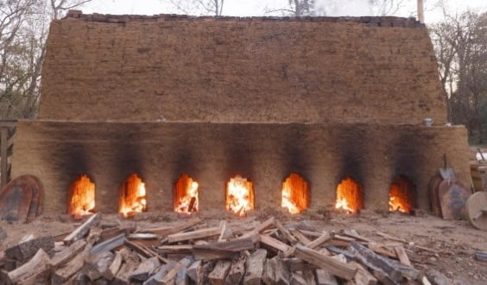
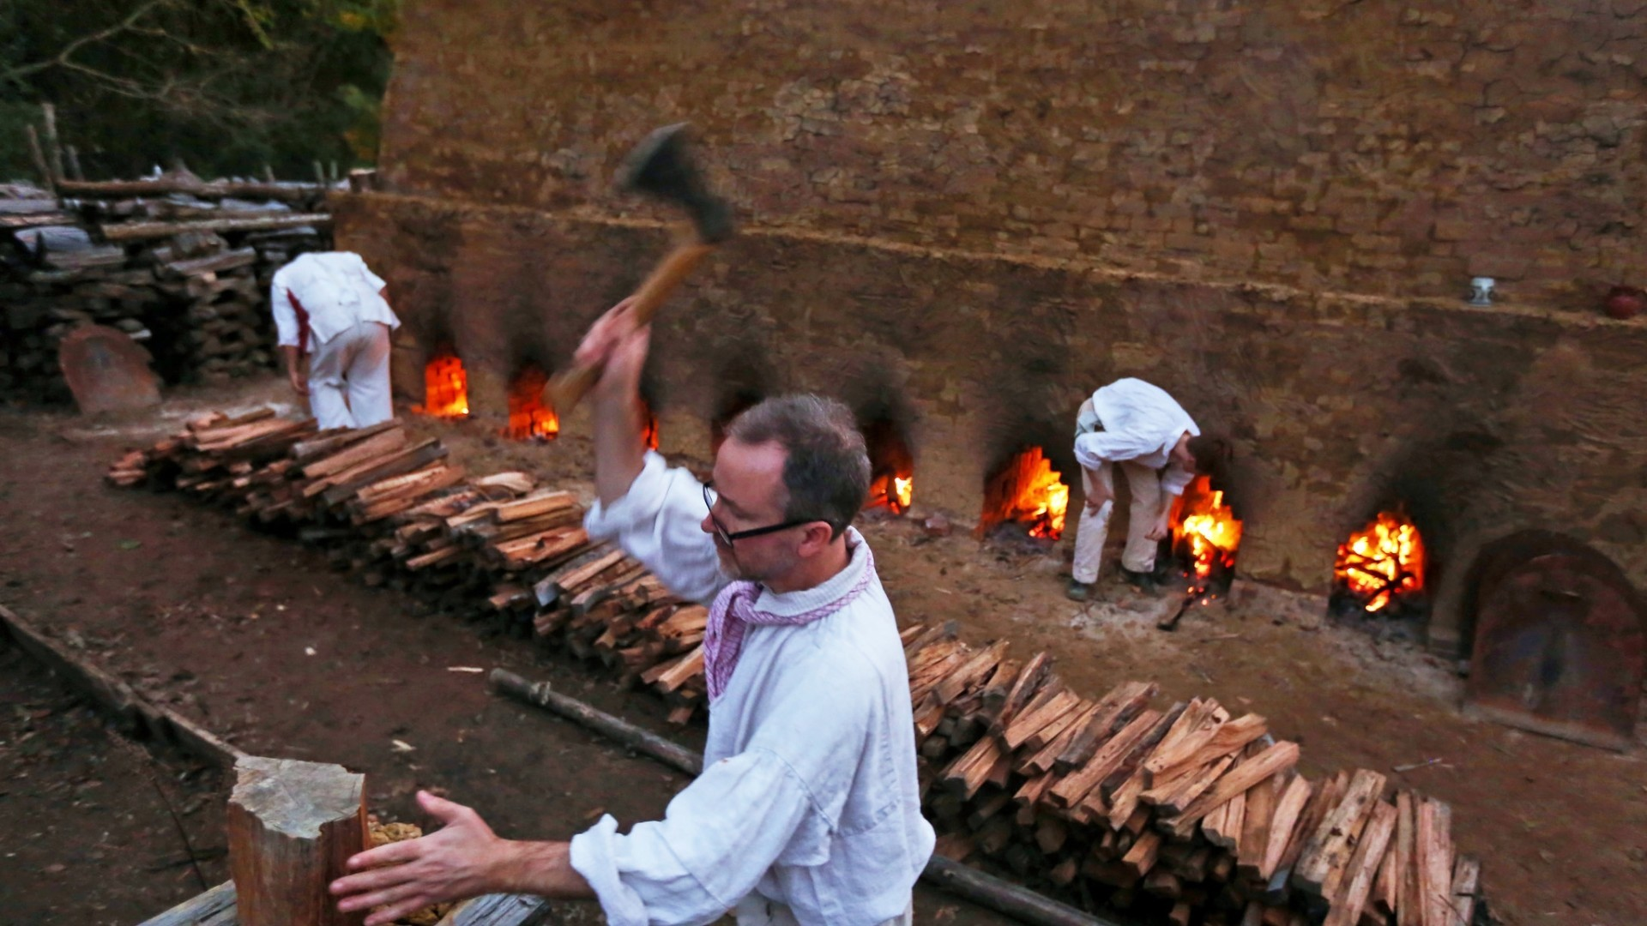
TRADITIONAL WAY
.

Slide 7
METHODS OF KILNS
Down Draught Kiln
Coal Fired
Fixed Chimney Bull's Trench Kiln
Clamps Kiln
Tunnel Kiln
Zigzag Kiln
Vertical Shaft Brick Kiln
Bull's Trench Kilns
.

Slide 8
Literature Survey
S.No | AUTHOR /YEAR | METHODOLOGIES
1. | Garay Aquino; Dennis Raul; Carlos Quispe Anccasi: | Proposal for Implementation of Induction Stoves for Electrification of the Peruvian Energy Matrix The chosen of use induction stoves instead of gas stoves were based on the five fundamental aspects of the efficient energy transition: affordability, competitiveness, efficiency, environmental sustainability, and safety, and not for dogmatism or chosen by a committee.
2. | urmu M. Debele, Xiao Qian | Automatic Room Temperature Control System Using Arduino UNO R3 and DHT11 Sensor The DHT11 sensor senses the surrounding room temperature and gives the result in degrees Celsius. Both the reference and the measured values are displayed on the Liquid Crystal Display (LCD).
3. | Oleh Pihnastyi, Georgii Kozhevnikov, Svitlana Cherniavska | Conveyor Belt Speed Control Efficiency Using the Energy Management Methodology The article presents an algorithm for optimal regulation of the step speed using the energy management methodology. Methods of reducing the cost of transport costs for conveyor systems are considered.
.

Slide 9
HARDWARE AND SOFTWARE REQUIREMNTS
Hardware Requirements
AC power supply
Voltage step down transformer
Rectifier
Arduino
Weighing sensor
Electrical chamber
Software Requirements
C programming (To display the Temperature and delay function)
.

Slide 10
EXISTING AND PROPOSED SYSTEM
Existing System
The majority of bricks used are made from clay and shale; they are used preliminary in the
construction of walls by bleeding and jointing of bricks into established bonding arrangement.
They are natural earthy fine grained minerals of secondary origin and composed of an aluminates silicate structure with an additional iron, alkalis and alkaline earth element.
Common clays are sufficiently plastic to permit ready molding and when firing, they vitrify below 1100°C.
.

Slide 11
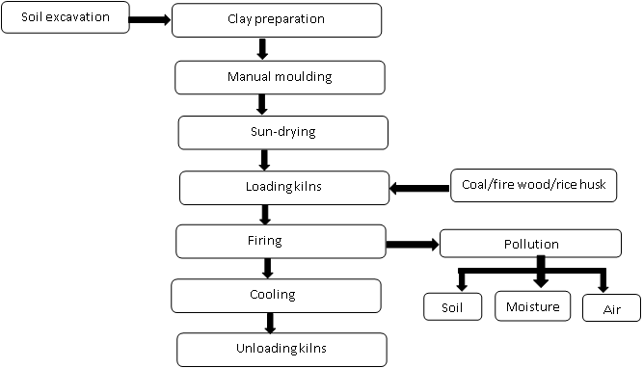
Existing System
.

Slide 12
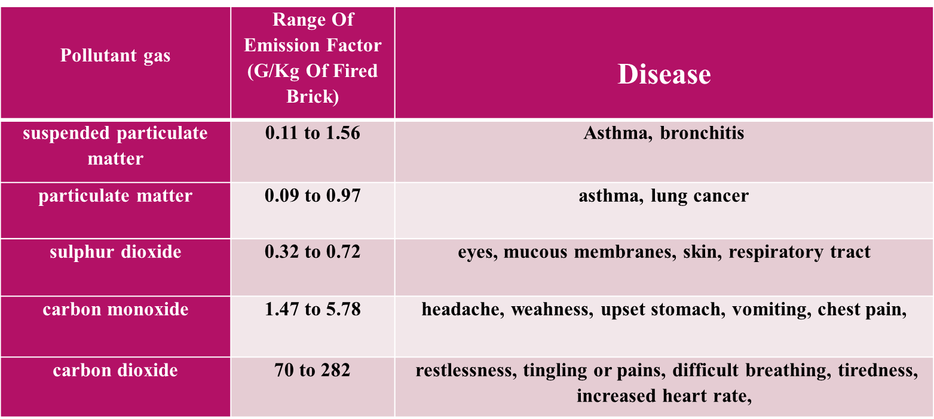
Causes of Existing System
.

Slide 13
PROPOSED SYSTEM
Proposed System
The brick industry continues to seek more sustainable means of manufacturing as using alternative fuel sources and incorporating recycled content in order to alleviate the hazardous impacts of the GHG emission and save the non-renewable source of energy from the none escapable depletion.
The brick industry has recently encountered a substantial evolution represented by launching new approaches in manufacturing non fired bricks.
From the economical and environmental point of view, the unfired bricks diverse sharply from the conventional fired brick.
Developing bricks by more sustainable, sophisticated, constitutional and eco- friendly approach will contribute to environmental protection.
.

Slide 14
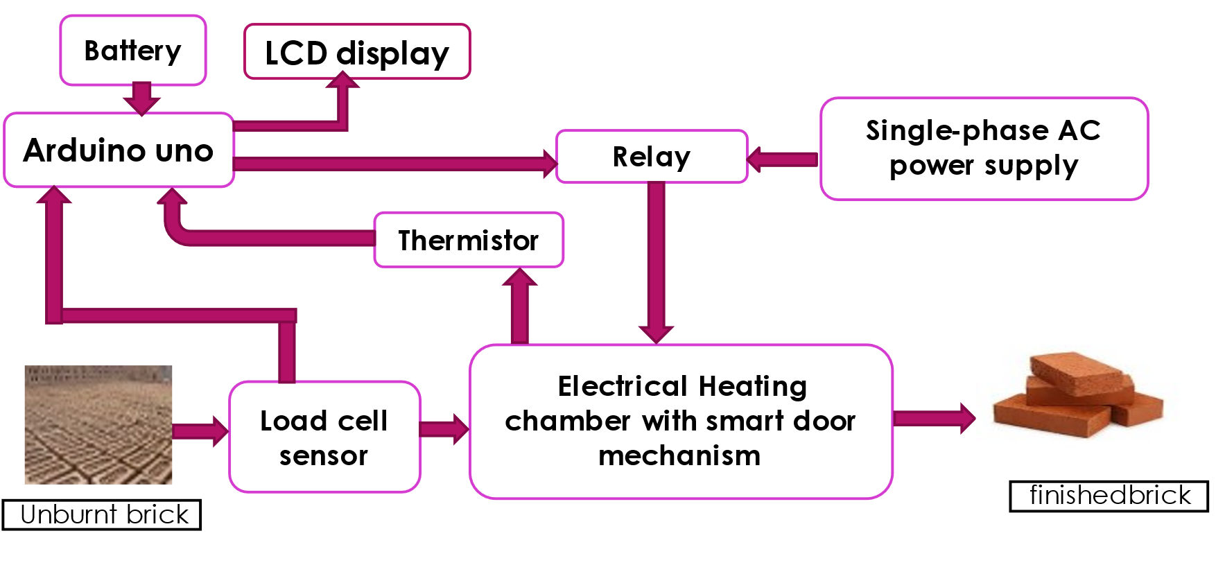
BLOCK DIAGRAM
.

Slide 15
COMPONENTS
AC power supply
Relay
LCD display
Arduino
Thermistor
Load cell
Electrical Heating chamber
Non-burnt clay brick
Burnt clay brick
.

Slide 16
WORKING PRINCIPLE OF HARDWARE REQUIREMENTS
AC power supply:
An AC power supply is a type of power supply used to supply alternating current (AC) power to the hole circuit.
Here we are using the power supply which is used in domestic purpose i,e. single phase, 230v, 50Hz.
Voltage step down transformer:
The transformer which will convert high voltage levels to low voltage levels with out changing frequency (230v to 12v).
.

Slide 17
WORKING PRINCIPLE OF HARDWARE REQUIREMENTS
Rectifier:
A rectifier is an electronic device that converts an alternating current into a direct current by using one or more P-N junction diodes.
A diode behaves as a one-way valve that allows current to flow in a single direction. This process is known as rectification.
Arduino:
Arduino is an open-source electronics platform based on easy-to-use hardware and software.
Arduino boards are able to read inputs - light on a sensor, a finger on a button, or a Twitter message - and turn it into an output - activating a motor, turning on an LED, publishing something online.
.

Slide 18
WORKING PRINCIPLE OF HARDWARE REQUIREMENTS
Weighing sensor:
It converts an input mechanical force such as load, weight, tension, compression, or pressure into another physical variable, in this case, into an electrical output signal that can be measured, converted and standardized.
As the force applied to the sensor increases, the electrical signal changes proportionally.
Electrical Heating chamber:
Heat Chambers are used for gentle, temperature accurate thermal treatment of components in the area of electronic power controller production. Inert-gas atmosphere supports this process.
.

Slide 19
WORKING PRINCIPLE OF HARDWARE REQUIREMENTS
Non burnt clay brick:
It is a raw brick which contains moisture and with poor mechanical strength.
Initial it is kept under the sun light to convert wet brick to semi dry brick. Here this semi dry brick is input to the heat chamber.
Burnt clay brick:
It is the finished brick which is completely burnt and came from the heating chamber also it having high mechanical strength compare to semi dry brick.
It can be directly used to construct the walls.
.

Slide 20
WORKING PRINCIPLE
At starting the semi dry brick kept on the weighing sensor and the weighing sensor will chick the weight of the semi dry brick and it sends signal to the arduino uno.
The function of arduino uno is to set the duration of time that the brick need to kept in the inside of the heating chamber.
After checking the weight of the brick the brick can be kept in the inside of the heating chamber with certain duration of time which will be fixed by the arduino uno.
After burning the brick with given duration of time the smart door will automatically opens.
The burnt brick or finished brick was taken from the heating chamber with the help of automation.
After that the burnt bricks will be kept at outside for cooling and it is stored.
.

Slide 21
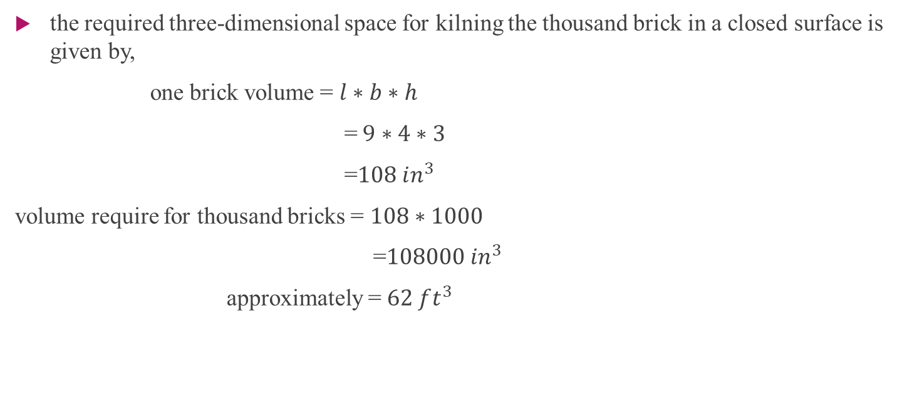
THE CHAMBER SPACE REQUIRED FOR 1000 BRICKS
.

Slide 22
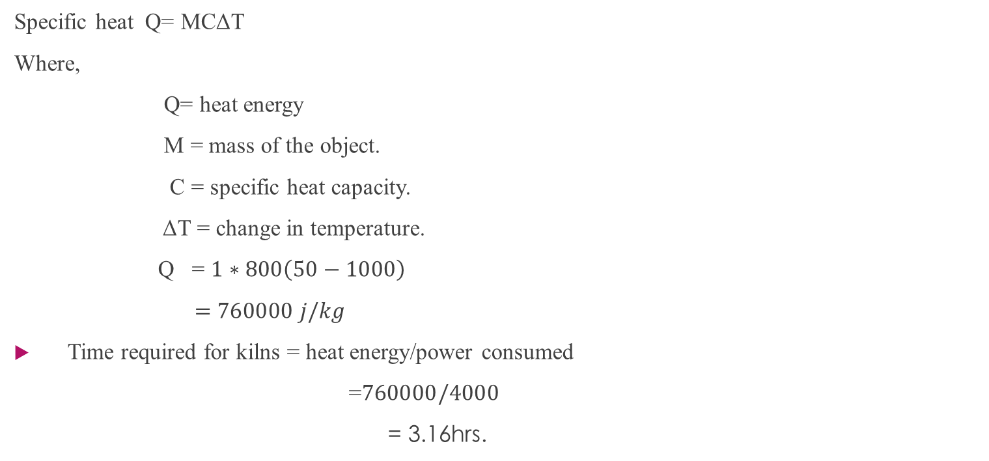
TIME REQUIRED FOR ONE-TIME KILNS PROCESS
.

Slide 23
POLLUTION CAUSED BY VARIOUS METHODS OF KILNS
.

Slide 24
ADVANTAGES
The instant finished brick (to construct the wall) is possible.
Zero emission of carbon.
It will avoid contributing in global warming and polluting the atmospheric air much more.
It is able to kiln the less quantity of bricks.
Deforestation can be reduced(zero).
Less man power is required.
All time(all seasons) production is possible.
The space required for the kilns process is very less compared to the traditional brick kilns process.
The high quality of bricks is appaired from the machine and no wastage of bricks.

Slide 25
FUTURE SCOPES
Our proposed solution is that it can be easily integrated with solar power generation which will reduce the electricity bill and also contribute to environmental sustainability. This system is reliable, efficient, and cost-effective, and we believe it will meet your needs and expectations.
We can also implement monitoring and quality check of bricks (without any defects and cracks in the bricks).
In the upcoming days, the proposed system can be established for the large production of bricks.
We can also use this method for drying the wet brick by maintaining the required temperature within the chamber.

Slide 26
CONCLUSION
From this project, we are concluding that by optimizing the kiln process, This system can ensure a uniform and efficient heating of the bricks, reducing energy consumption and the emissions of greenhouse gases.
By implementing this system, we can achieve a more accurate and efficient method of brick kiln process, that can produce hard and strong bricks, without compromising the environment or human resources

Slide 27
REFERENCE
American Institute of Architects, Environmental Resource Guide, The American Institute of Architects, Canada, 1998.
Campbell, J. W. P. and Pryce, W., Brick, A World History, Thames and Hudson, New York, NY, 2003.
Proposal for Implementation of Induction Stoves for Electrification of the Peruvian 00000Energy Matrix, Garay Aquino; Dennis Raul; Carlos Quispe Anccasi.
Automatic Room Temperature Control System Using Arduino UNO R3 and DHT11 Sensor, Gurmu M. Debele, Xiao Qian.
Arduino-based Automated Dosage Prescription using Load Cell, A.Rasheedha; K. Srinathi; T. Sivalavanya; R.R. Monesha.
Arduino-based Auto Door unlocks control system by Android mobile through Bluetooth and Wi-Fi, M. Muthumari; Nitesh Kumar Sah; Rishu Raj; Jyotikinkar Saharia.
Linearization of NTC Thermistor Characteristic Using Op-Amp Based Inverting Amplifier, Aloke Raj Sarkar, Debangshu Dey, Sugata Munshi.

Slide 28


